Slide 1

DEPARTMENT OF COMPUTER SCIENCE AND ENGINEERING
IV-YEAR B.TECH (2019-2023)
A MAJOR PROJECT ON
Mining Users Trust From E-Commerce Reviews Based on
Sentiment Similarity Analysis
UNDER THE ESTEEMED GUIDANCE OF
N. VAISHNAVI
M. PRAVALIKA
M. VISHNU VARDHAN
P. VINEY KUMAR
- 195U1A0577
- 195U1A0574
- 195U1A0564
- 195U1A0593
Mrs. A. SRUTHI
(ASSISTANT PROFESSOR)

Slide 2
ABSTRACT
In recent years, e-commerce has become a popular way for consumers to purchase products and services online. However, with the rise of fake reviews and fraudulent behavior, it can be difficult for users to trust the reviews they read. This is where sentiment similarity analysis comes in.
Sentiment similarity analysis is a technique used to analyze the sentiment of reviews and compare them to other reviews to determine their authenticity.
By mining users' trust from e-commerce reviews based on sentiment similarity analysis, companies can ensure that their customers are receiving honest and reliable information
Consumers’ reviews in E-commerce systems are usually treated as the important resources that reflect user’s experience, feelings, and willingness to purchase item.
Many kinds of research have shown that people are more likely to trust each other with the same attitude toward similar things.
In this project, we consider seeking and accepting sentiments and suggestions in E-commerce systems somewhat implies a form of trust between consumers during shopping.

Slide 3
We divide the trust into two categories, namely direct trust, and propagation of trust, which represents a trust relationship between two individuals.
Using the proposed trust representation model, we use the shortest path to describe the tightness of trust and put forward an improved shortest path algorithm to figure out the propagation trust relationship between users.
Following this view of point, an E-commerce system reviews mining oriented sentiment similarity analysis approach is put forward to exploring users’ similarity and their trust.

Slide 4

AIM:
In this project, our aim is to analyze e-commerce reviews to determine which reviews are trustworthy and which are not. To do this, the sentiment of each review is analyzed to determine whether it is positive or negative. Reviews that are overly positive or overly negative may be considered untrustworthy, as they may be biased or fake.

Slide 5
PROBLEM STATEMENT
In e-commerce, reviews play a critical role in building users' trust in a product or service. However, it can be challenging for users to read and analyze multiple reviews, especially for products with a large number of reviews.
To address this challenge, sentiment similarity analysis can be used to analyze the sentiment of reviews and identify patterns in the data. The system can then use this information to generate an overall trust score for a product or service.
This score can be used by users to make informed decisions about whether to purchase the product or service.

Slide 6
LITERATURE SURVEY
Over the past few years, many works have focused on the relationship analysis between trust and similarity. The similarity analysis based on sentiment has become an important research approach to establish trust relationship. Many studies have shown that there is highly correlation between trust and similarity. They demonstrated that individuals with similarities also have a high degree of trust in certain areas. These similarities include interest, content, behaviour, etc.
Cai-Nicolas Ziegler and J. Golbeck investigated correlations between trust and interest similarity. They established a formal framework for investigating interactions between trust and similarity. They used a mathematical model to compute similarity and presented computation algorithms for profile and profile similarity. They used two experiments to analyse possible positive correlations between similarity and interpersonal trust

Slide 7
OBJECTIVE
This project is to improve the quality of e-commerce reviews by identifying trustworthy reviews and filtering out untrustworthy ones. By doing so, the project aims to enhance the trustworthiness of e-commerce platforms and improve the overall user experience.
To show customer reviews based on sentiment similarity analysis in E-commerce systems can be an efficient method to find trust between users.
To enhance business strategies for the better outcomes in E-commerce

Slide 8
EXISTING SYSTEM
There are several architectures with different algorithms to obtain the score of the product. A lot of studies have devoted in the inclusion of the semantic analysis to obtain the trust. Even in a lot of update methods there are a lot of issues like credibility of referees, the update of the trust degree of the user at any intervention, the age of the rating and therefore the feedback or the concordance or the agreement between the given rating which may be a scalar value and therefore the textual feedback associated to it.
In the field of E-commerce reviews, people are more concerned about the credibility of reviews and the trust of user who post the reviews. These reviews are important to the business holders as they can take business decisions according to the analysis results of users' opinions about their products.

Slide 9
DRAWBACK IN EXISTING SYSTEM:
Most of the existing methods focus on exploring the overall trend of some sentiment or emotional tendencies to classify users by text sentiments. They do not take into account the similarity of sentiment between individuals and trust relationship between users.

Slide 10
PROPOSED SYSTEM:
In our proposed work trust representation model, we use the shortest path to describe the tightness of trust and put forward an improved shortest path algorithm to figure out the propagation trust relationship between users.
A large-scale E-commerce website reviews dataset is collected to examine the accuracy of the algorithms and feasibility of the models. The experimental results indicate that the sentiment similarity analysis can be an efficient method to find trust between users in E-commerce systems.
By defining two kinds of trust relationship, namely, direct trust and propagation trust. Establish a weighed trust graph model for propagation trust computing.

Slide 11
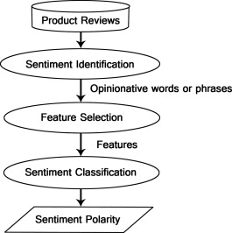
SYSTEM ARCHITECTURE:

Slide 12
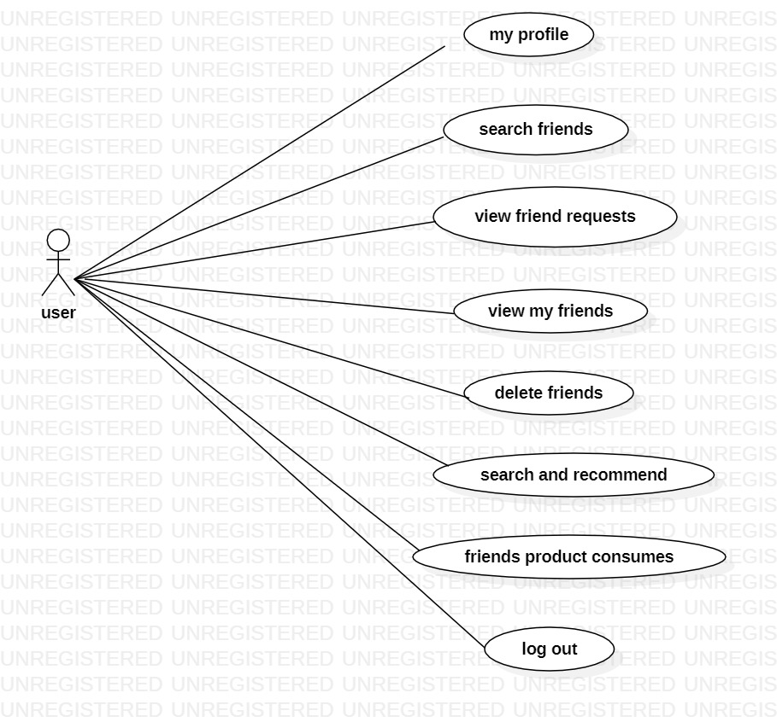
USE CASE DIAGRAM(User):

Slide 13
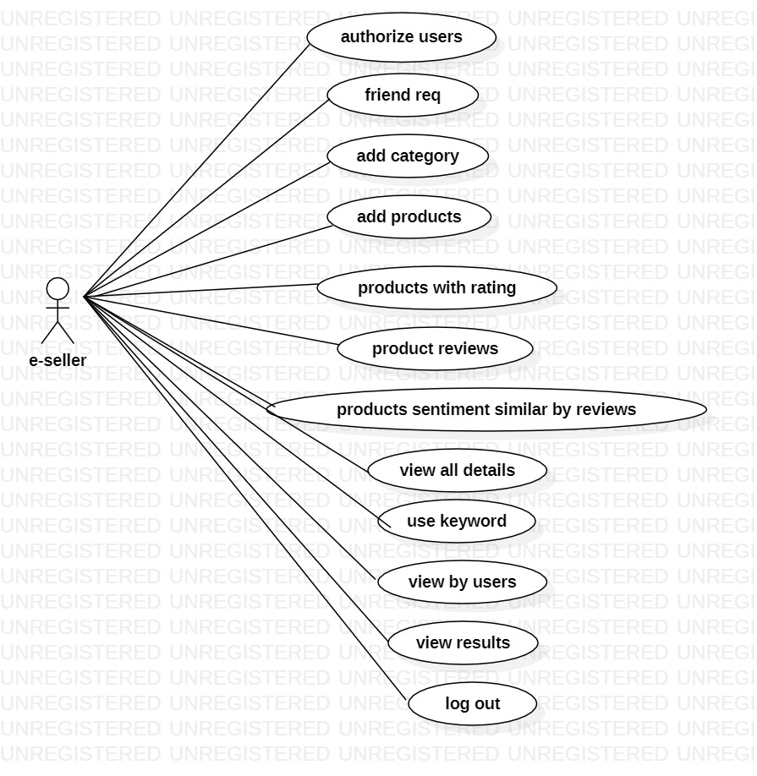
USE CASE DIAGRAM(Admin):

Slide 14
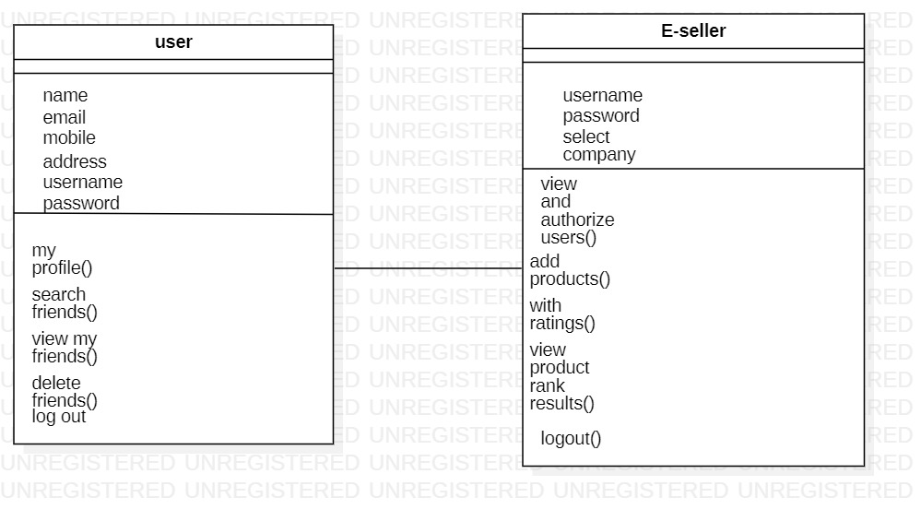
CLASS DIAGRAM:

Slide 15
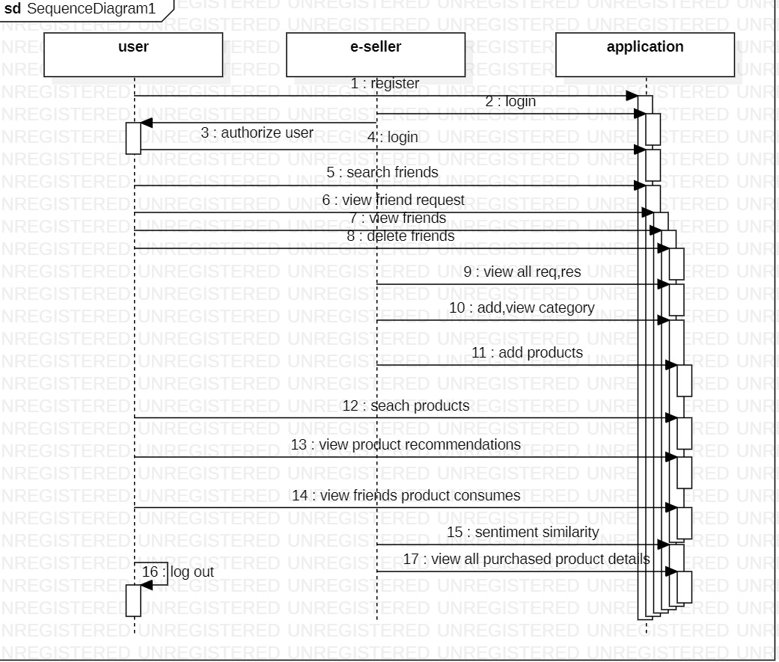
SEQUENCE DIAGRAM:

Slide 16
Algorithms and techniques used in this project:
K-Nearest Neighbour:
K-Nearest Neighbour is one of the simplest Machine Learning algorithms based on Supervised Learning technique.
K-NN algorithm assumes the similarity between the new case/data and available cases and put the new case into the category that is most similar to the available categories.
K-NN algorithm stores all the available data and classifies a new data point based on the similarity. This means when new data appears then it can be easily classified into a well suite category by using K- NN algorithm.
Natural Language Processing:
Natural language processing (NLP) is a machine learning technology that is used by machines to understand, analyse, manipulate, and interpret human's languages.
Syntax and semantic analysis are two main techniques used with natural language processing.

Slide 17
IMPLEMENTATION MODULES:
User Module
Here the user, one of the module and the user should register with the application after the registration the user must be authorized by the e-seller admin. Then only the user can able login with the application.
After the user successful login, the user can able to perform the following operations such as
My Profile ,Search Friends
View Friend Requests
View My Friends
Manage Bank Account
Search Products And Recommend
View Post Recommend
Purchase cart products
Mt Purchased Products
Logout

Slide 18
Admin Module (E-Seller)
Here the e-seller is the main module and e-seller can login directly with the application and after the successful login the e-seller can able perform the some operations such as,
View Users And Authorized
View Friend Request & Response
View All Spam Accounts
Add Products Categories
Add Products
Delete Products Posts
View Purchased Product
View All Products Posts
View Products Reviews On Posts
View +ve & -ve Product Reviews
View All Spam Reviews
View Positive Review Chart
View Negative Review Chart

Slide 19
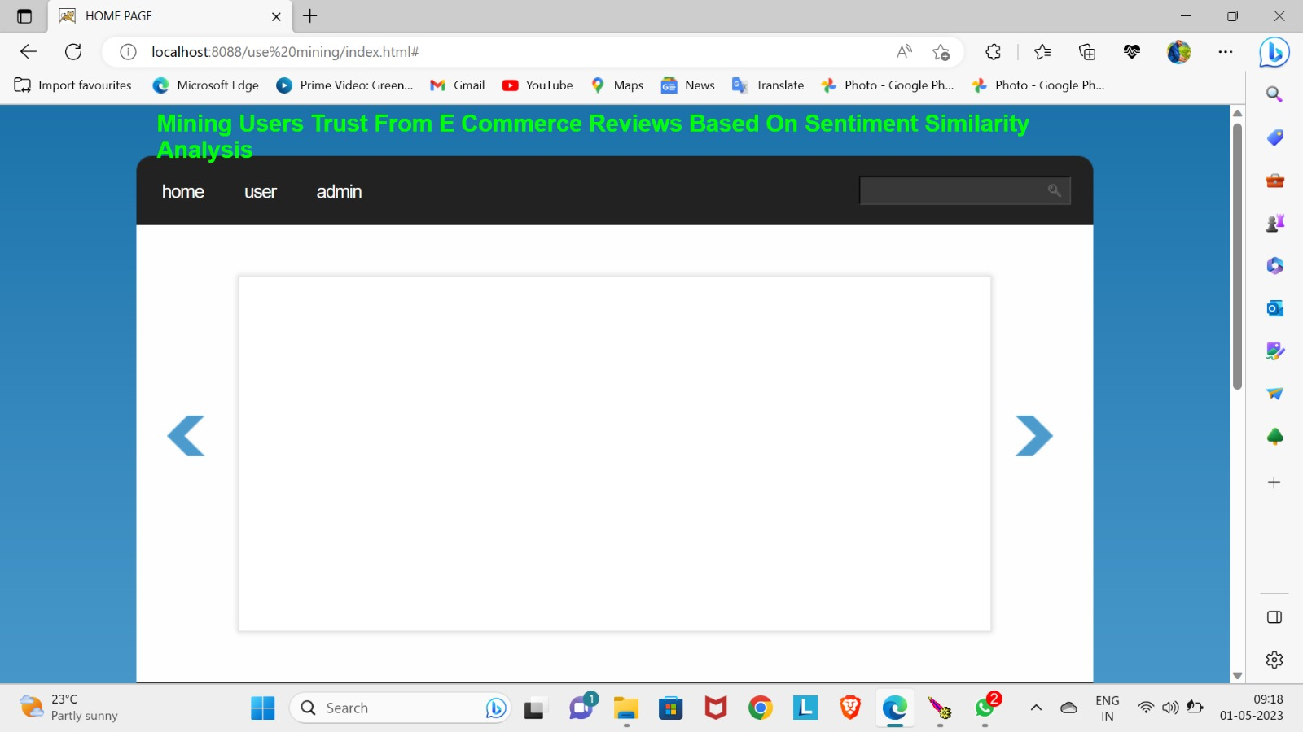
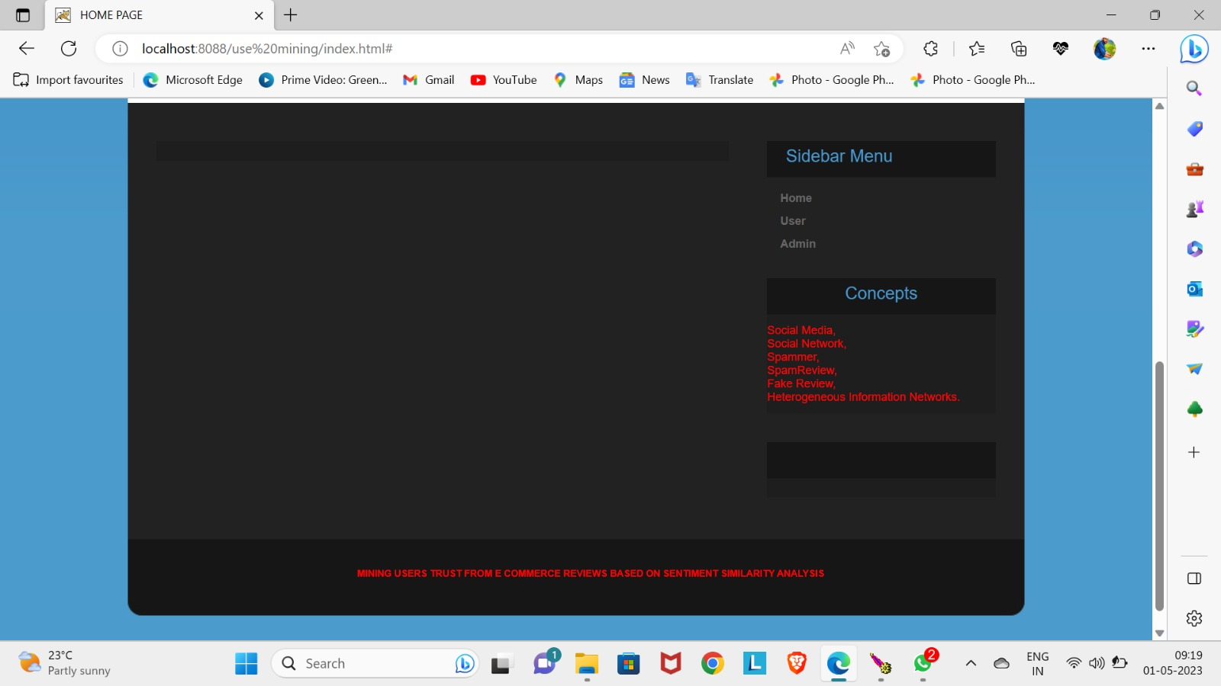
EXECUTION SCREENSHOTS:

Slide 20
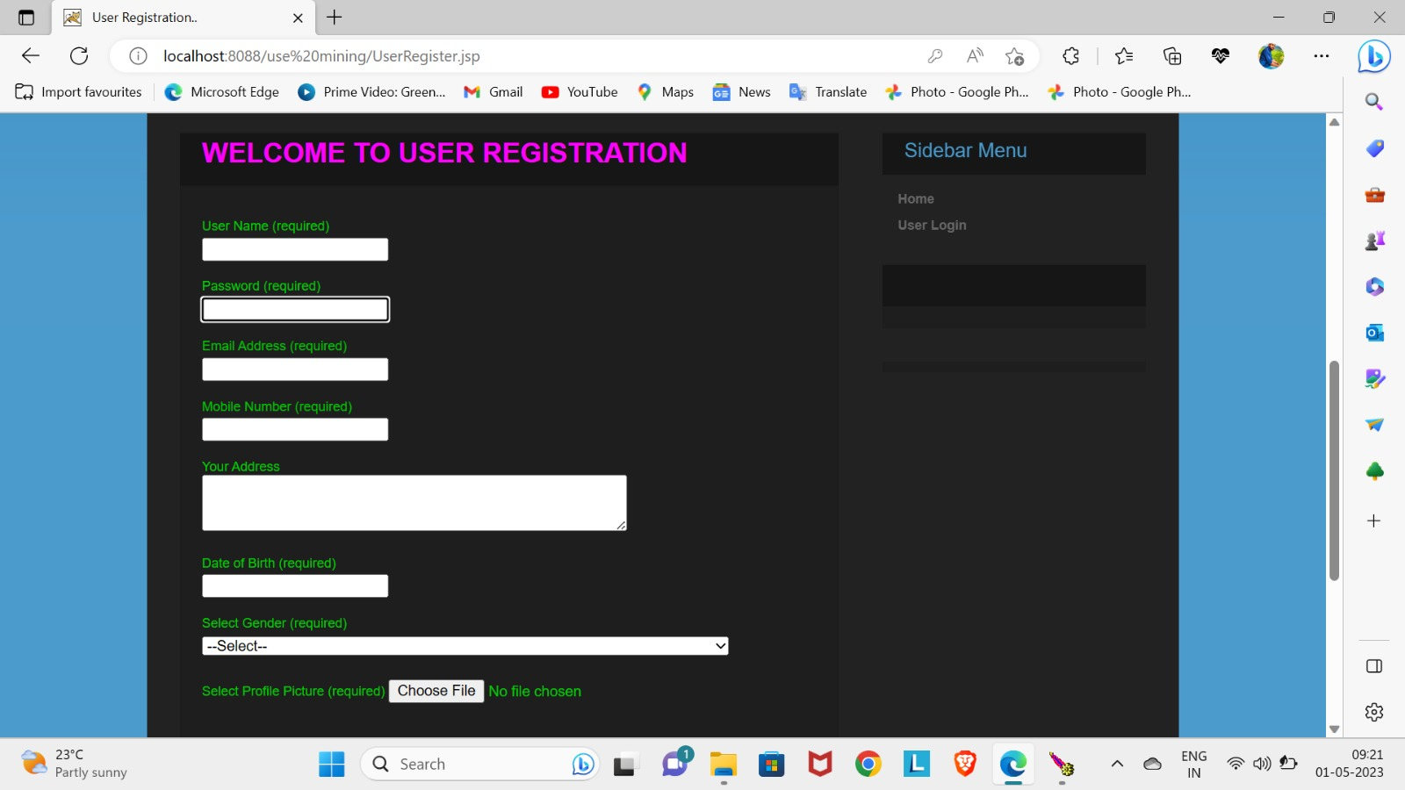
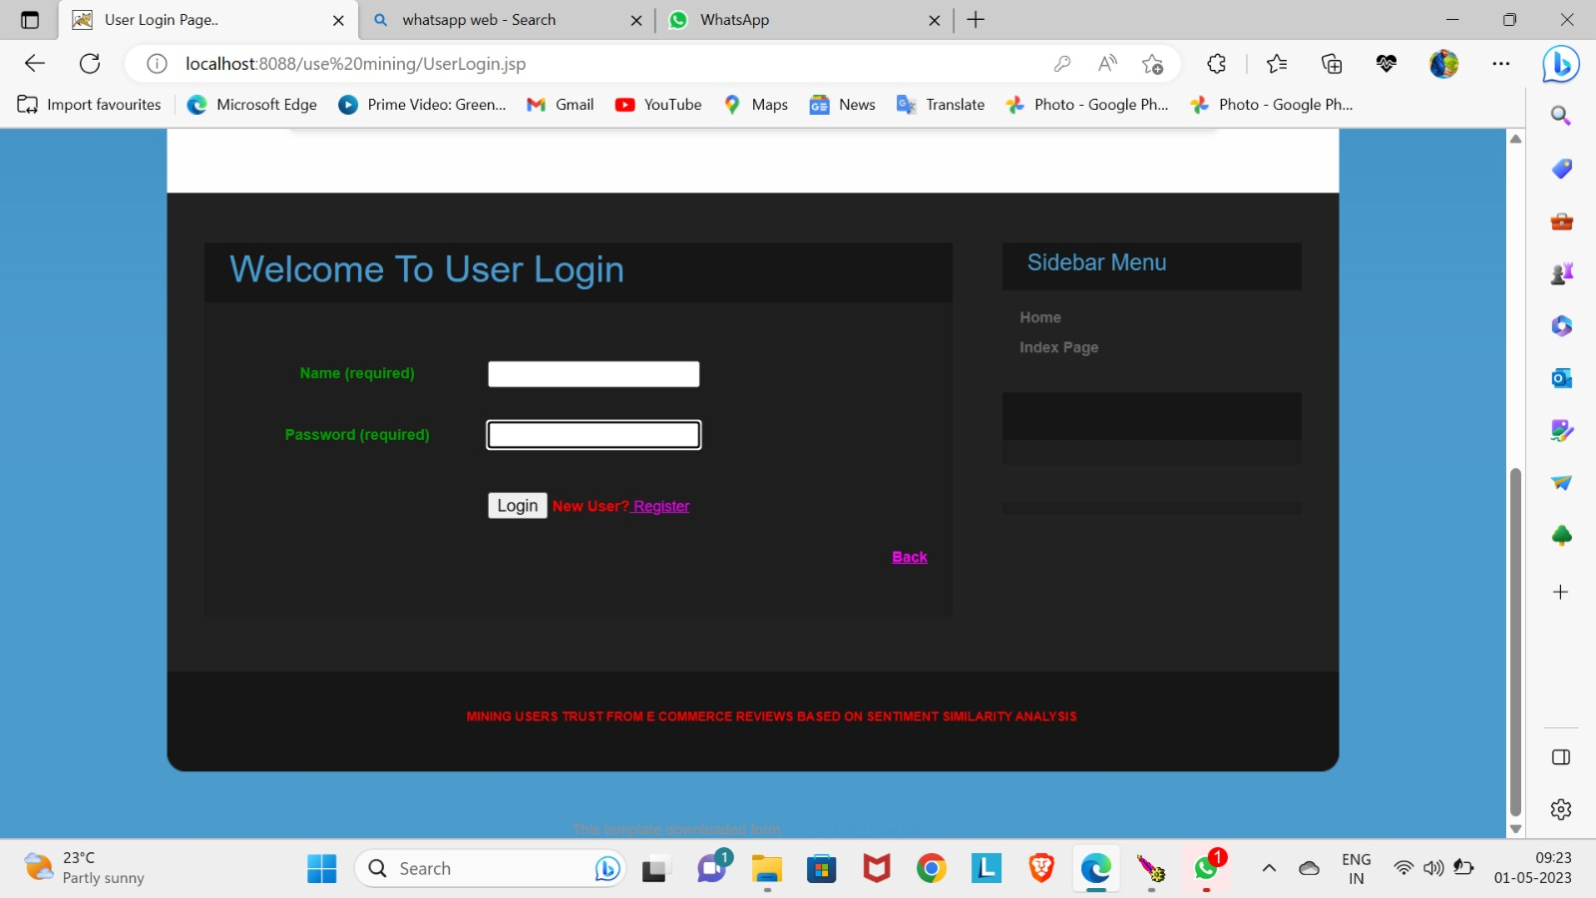
User Registration:
User Login:

Slide 21
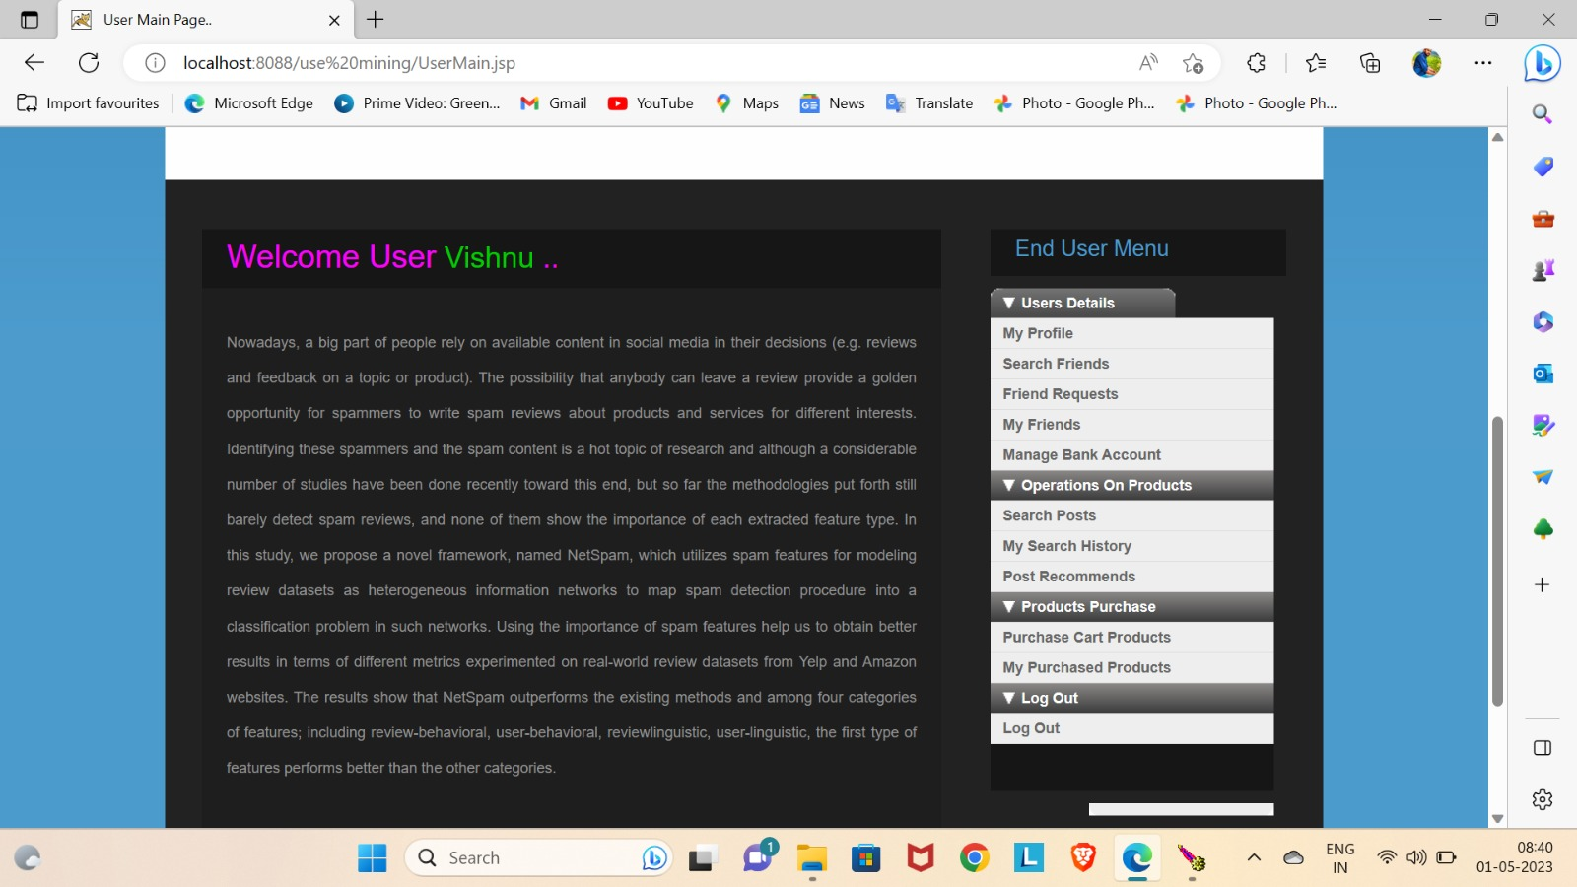
User Home:

Slide 22
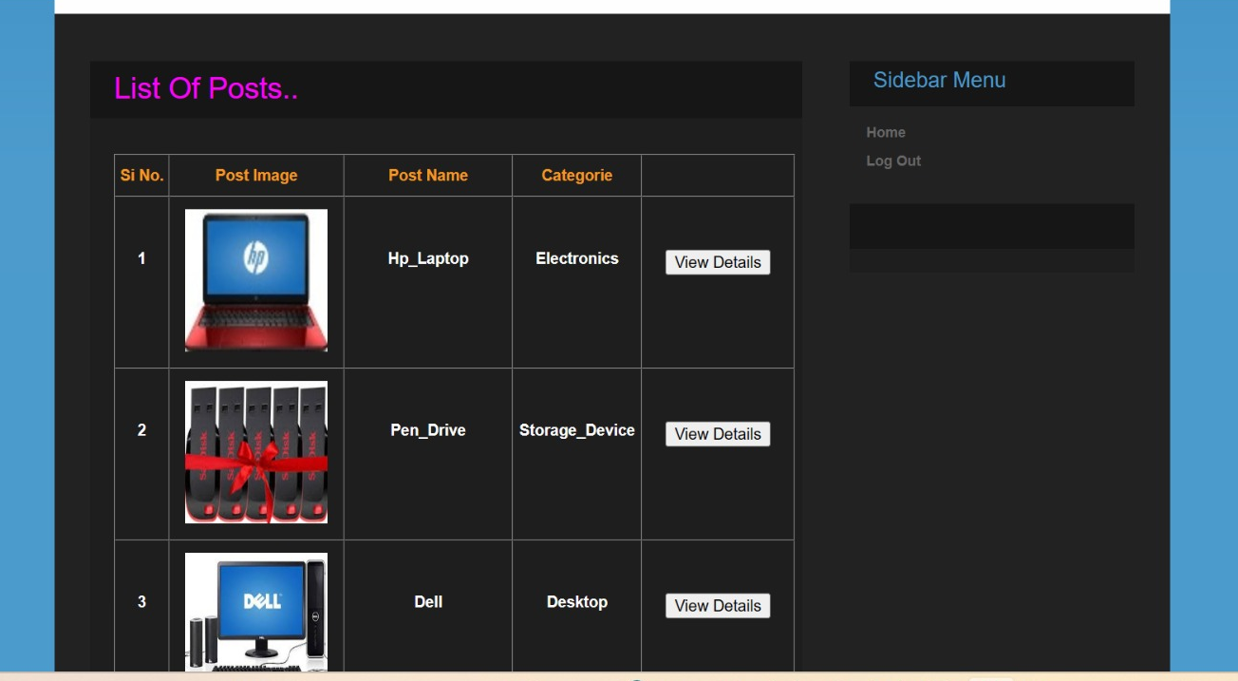
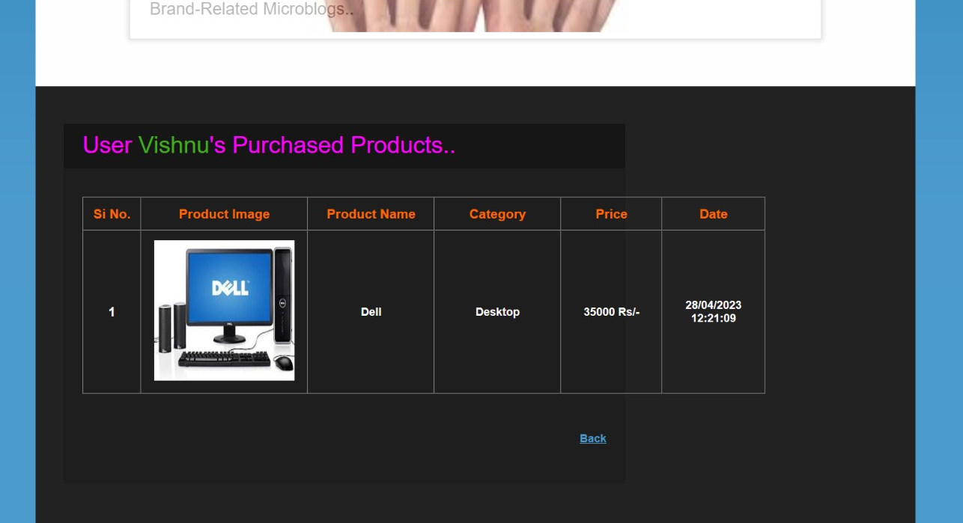
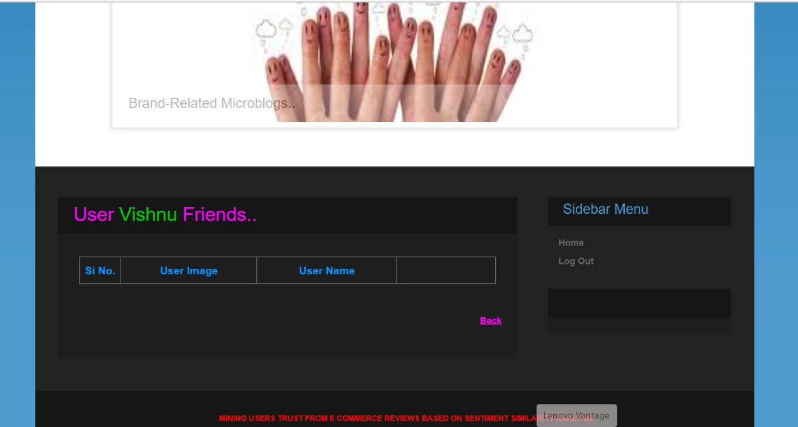
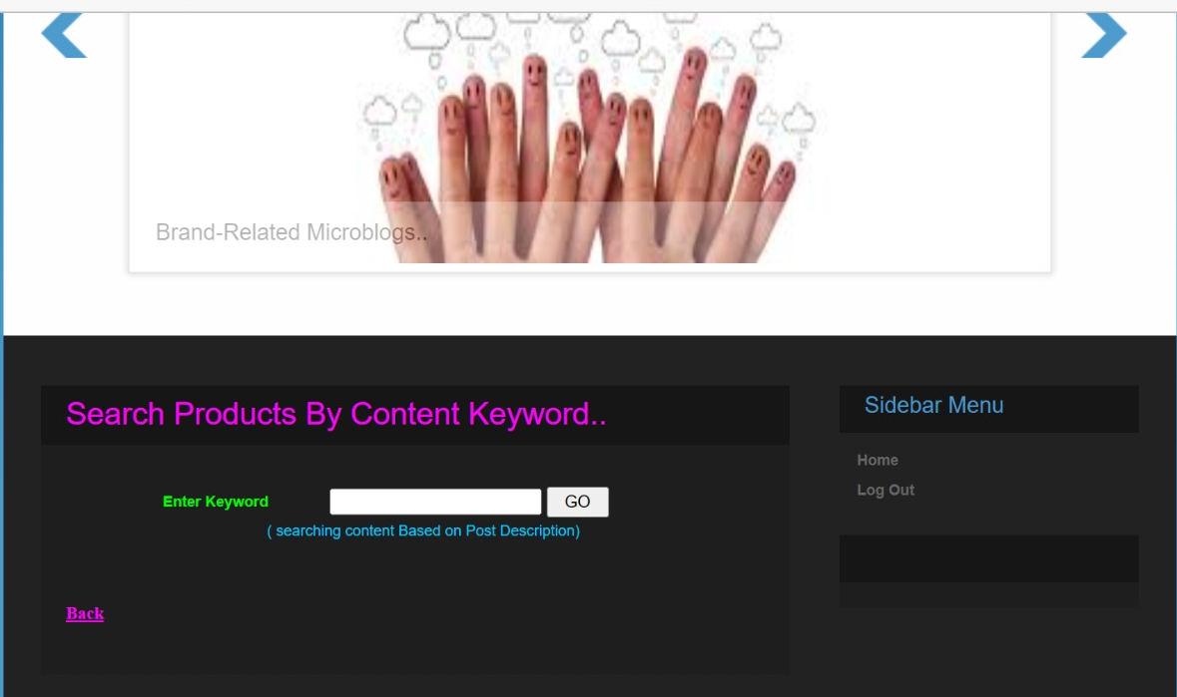

Slide 23
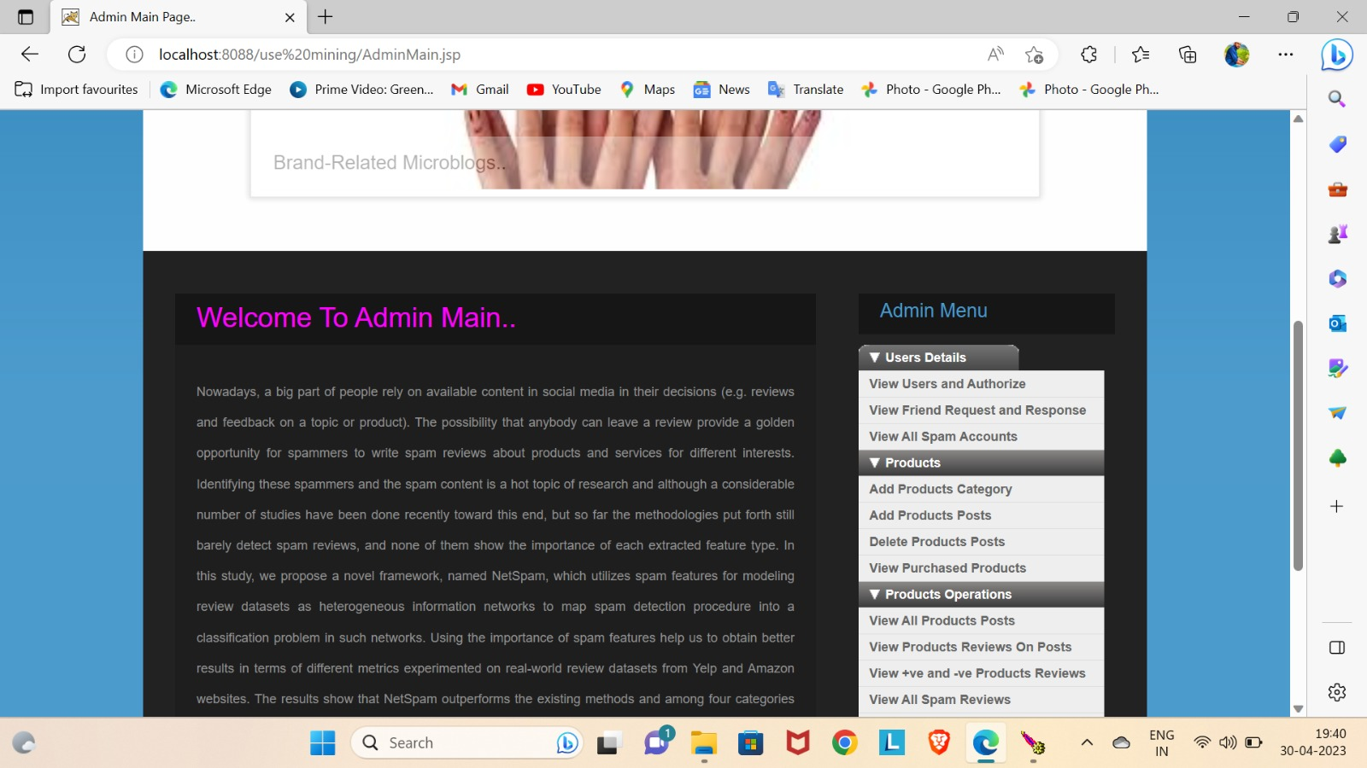
Admin Home:

Slide 24
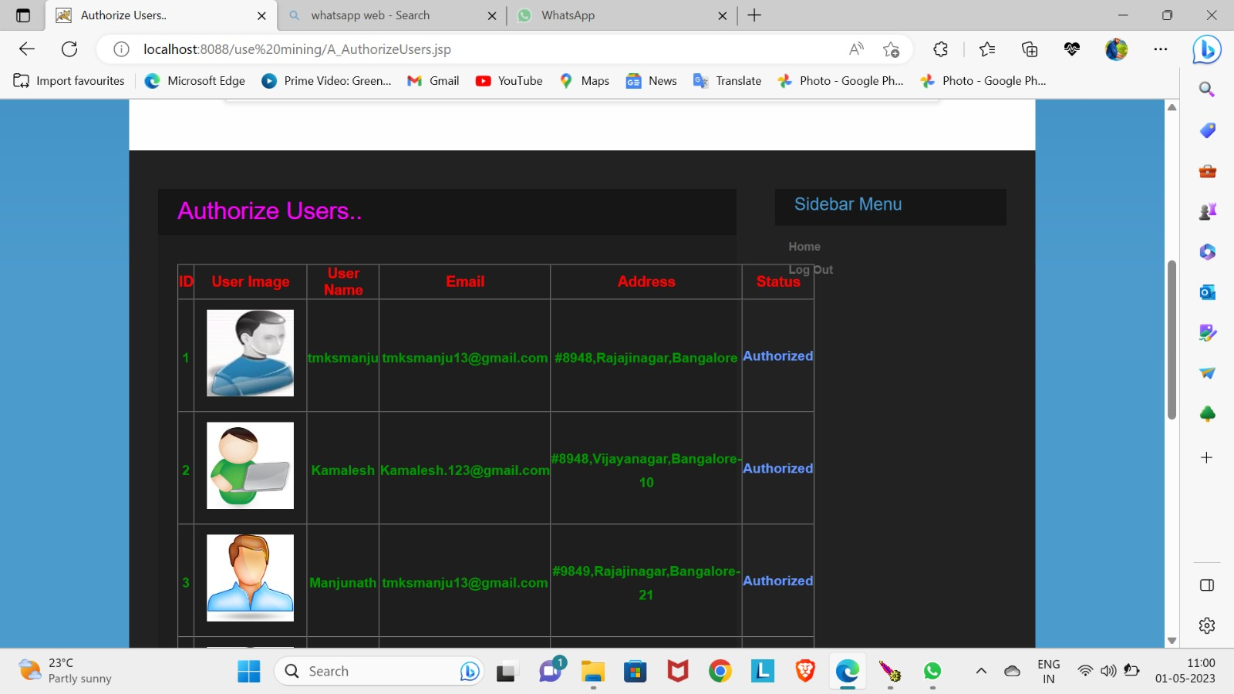
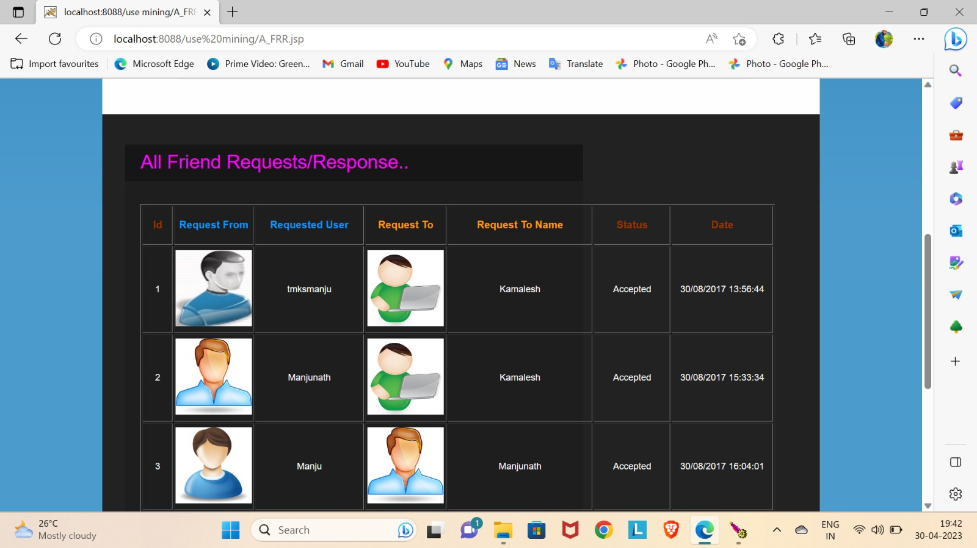
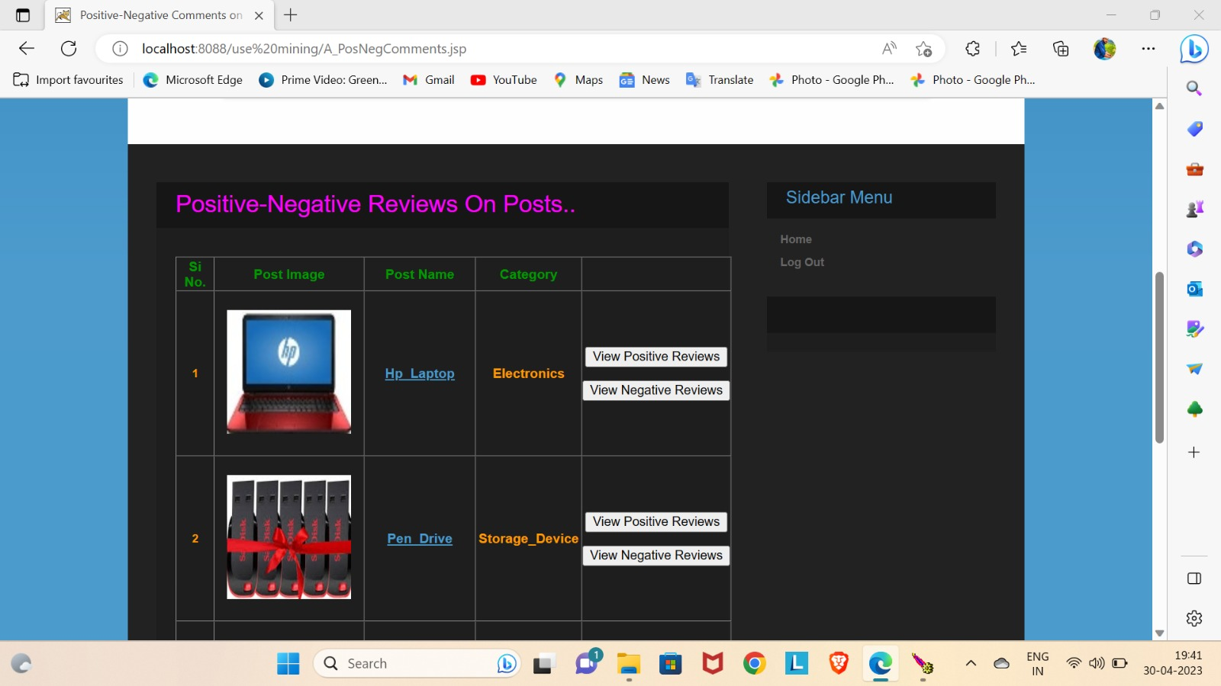
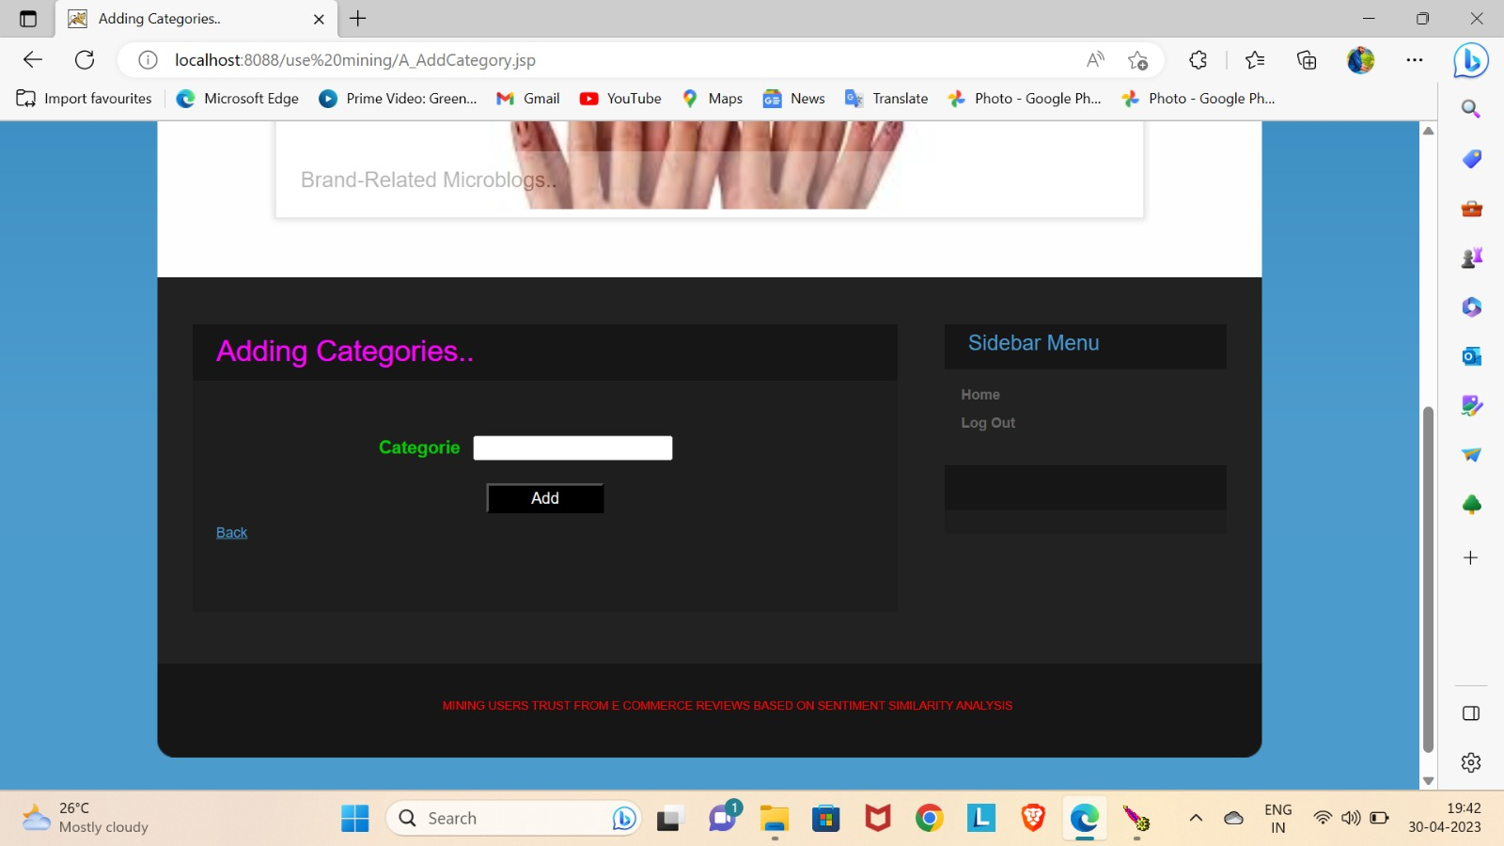

Slide 25
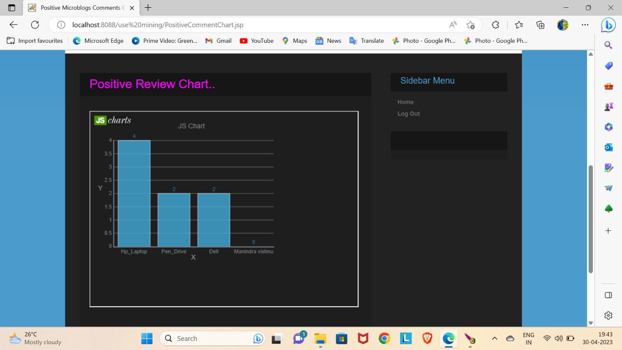
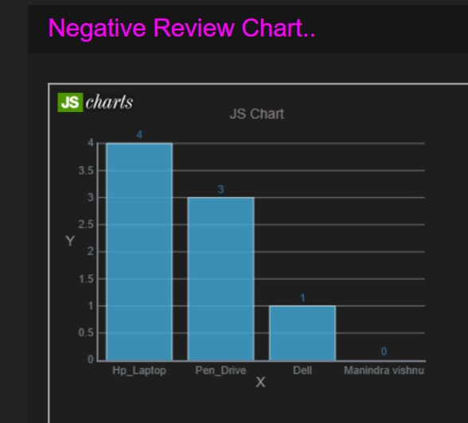
Chart Results:

Slide 26
FUTURE ENHANCEMENT
There are several valuable study of sentiment similarity and trust in E-commerce field in the future:
Not each user gives their reviews on each item, so the user’s reviews data are usually sparse for a particular item. how to explore similarity of users with extremely sparse reviews data, e.g. by designing more efficient algorithm to overcome the challenge;
The degree to which people trust others is different for different things. Under more stringent requirements, it is also necessary to distinguish the categories of trust targets in details. how to include other information, for example, purchase item category, brand and other activities, into user sentiment calculation framework.

Slide 27
CONCLUSION
In conclusion, mining user trust from e-commerce reviews based on sentiment similarity analysis is a powerful tool for companies looking to establish themselves as trustworthy brands in the marketplace. By providing honest and reliable information to their customers, they can build a loyal customer base and increase sales. At the same time, consumers benefit from having access to honest and reliable information about products and services, leading to greater satisfaction with their purchases and a more positive overall shopping experience.

Slide 28

Thank you

